Slide 1

Airplane Crash Analysis A Mentorness Project By Lakshya Kumar Gauriyan

Slide 2
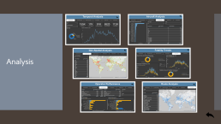
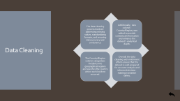
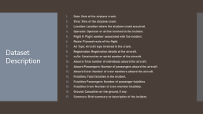
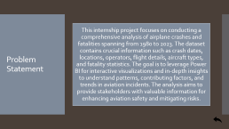
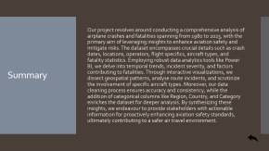
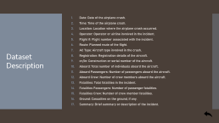
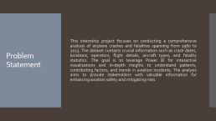
Table of Contents
Problem Statement
Dataset Description
Data Cleaning
Analysis
Summary

Slide 3

Problem Statement
This internship project focuses on conducting a comprehensive analysis of airplane crashes and fatalities spanning from 1980 to 2023. The dataset contains crucial information such as crash dates, locations, operators, flight details, aircraft types, and fatality statistics. The goal is to leverage Power BI for interactive visualizations and in-depth insights to understand patterns, contributing factors, and trends in aviation incidents. The analysis aims to provide stakeholders with valuable information for enhancing aviation safety and mitigating risks.

Slide 4
Dataset Description
Date: Date of the airplane crash.
Time: Time of the airplane crash.
Location: Location where the airplane crash occurred.
Operator: Operator or airline involved in the incident.
Flight #: Flight number associated with the incident.
Route: Planned route of the flight.
AC Type: Aircraft type involved in the crash.
Registration: Registration details of the aircraft.
cn/ln: Construction or serial number of the aircraft.
Aboard: Total number of individuals aboard the aircraft.
Aboard Passengers: Number of passengers aboard the aircraft.
Aboard Crew: Number of crew members aboard the aircraft.
Fatalities: Total fatalities in the incident.
Fatalities Passengers: Number of passenger fatalities.
Fatalities Crew: Number of crew member fatalities.
Ground: Casualties on the ground, if any.
Summary: Brief summary or description of the incident.

Slide 5
Data Cleaning
The data cleaning process involved addressing missing values, standardizing formats, and ensuring data accuracy and consistency.
Additionally, new column - Country/Region, was added to provide contextual information and enhance the dataset's analytical depth.
The Country/Region column categorizes incidents into geographical regions and specifies the country where each incident occurred.
Overall, the data cleaning and enrichment efforts ensure that the dataset is well-prepared for accurate analysis and informed decision-making in aviation safety.

Slide 6
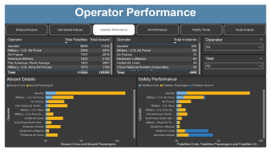
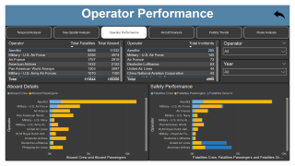
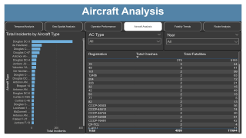
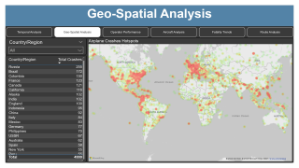
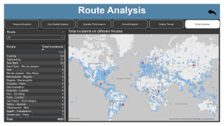
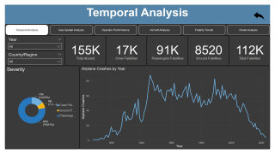
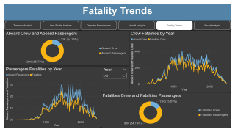
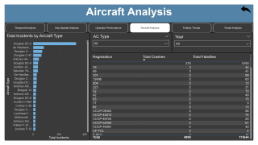
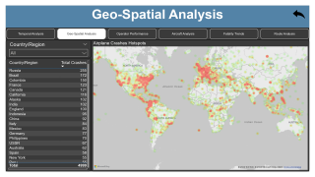
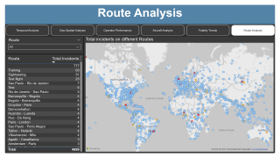
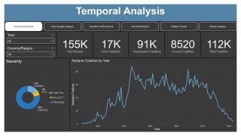

Analysis

Slide 7


Slide 8

Temporal Analysis
Here in the temporal analysis we can see that there are significant fluctuations in airplane crashes over the years.
Furthermore, during this analysis we also checked the fatalities stats. We can see that the fatalities are not limited to the persons aboard the aircraft, but the ground fatalities are also there.
Severity of the crashes are also shown in this analysis, where we found the severity of the crash, i.e. percentage of the fatalities in respect to the aboard persons.

Slide 9


Slide 10
Geo-Spatial Analysis
During the Geo-Spatial analysis, we visualize the locations where the crashes occurred. We found out the number of crashes in different regions.
We further analyse the number of crashes in different regions.
We also visualize the danger spots where most crashes occurs using the heatmap. This helps in recommending safety guidelines during the flights through these regions to minimize the fatalities.
We would check the summaries of these crashes to further pinpoint the crash reasons and take necessary actions.

Slide 11
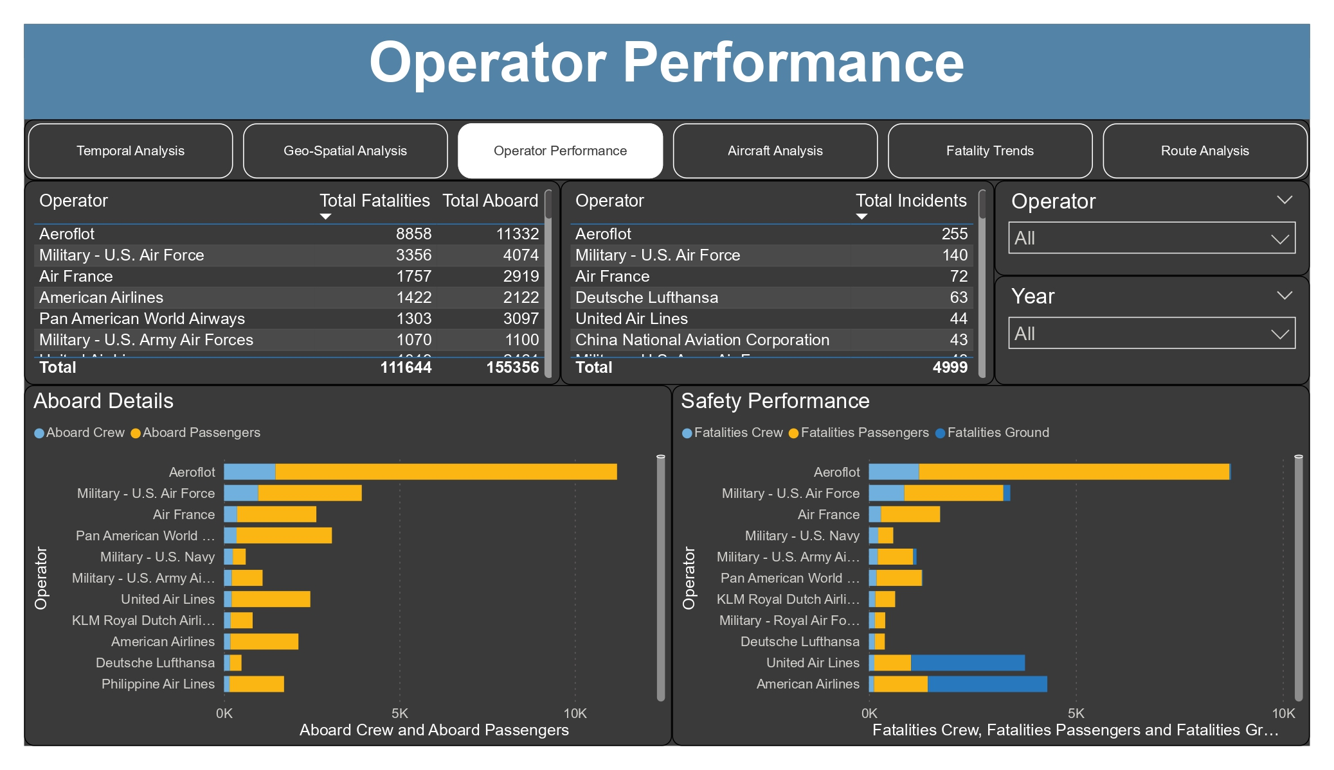

Slide 12
Operator Performance
This analysis gives us the performance matrix of flights of different operators and helps us evaluate the safety records of different airlines.
We find out that the Aeroflot has a high number of crashes and fatalities to its name.
Aeroflot can be considered the most unsafe airline out of all the operators data we had.
Aeroflot has a higher turnout of crashes and percentage of fatalities.

Slide 13
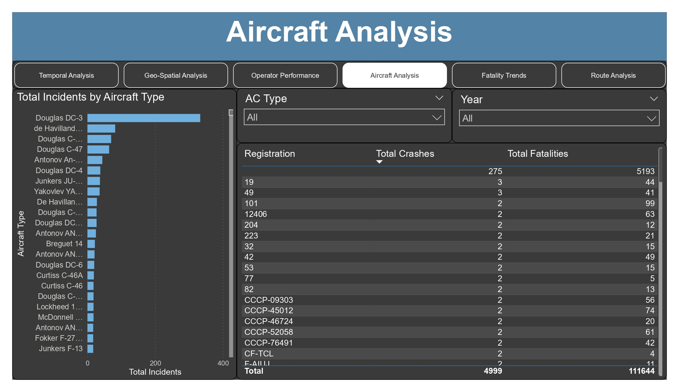

Slide 14
Aircraft Analysis
This analysis gives us the specific aircrafts which are involved in the most crashes worldwide.
We find out that Douglas DC-3 is involved in the most airplane crashes with above 300 crashes in total.
The registration of aircrafts and their relationship with the involvement in a crash tells us that unregistered aircrafts has the most involvements in crashes with 275 crash involvements.
This concludes that the unregistered aircrafts has manufacturing defects but these are used in flights anyways which leads to the crashes.

Slide 15


Slide 16
Fatality Trends
Exploring the trends in passenger and crew fatalities revealed fluctuations over the years, reflecting the dynamic nature of aviation safety.
Through interactive visualizations, stakeholders gained a deeper understanding of how fatalities have evolved over time. This analysis provided valuable insights into the effectiveness of safety measures and the impact of regulatory changes on reducing fatalities in airplane incidents.
An investigation into the factors contributing to fatalities unveiled essential insights for enhancing aviation safety measures. By analysing various variables such as aircraft type, operator, and incident severity, stakeholders gained valuable insights into the root causes of fatalities in airplane incidents.
This analysis facilitated the identification of risk factors and informed targeted interventions aimed at mitigating risks and improving safety standards.

Slide 17


Slide 18
Route Analysis
Route Analysis gives us the dangerous routes that most likely to have a crash.
This helps us in taking necessary steps to enhance safety of the passengers and mitigating the risks of involvement in a crash.
The map in this analysis shows the crash numbers on a certain route and differentiate the crashes based on the number of crashes with colour coding.

Slide 19
Summary
Our project revolves around conducting a comprehensive analysis of airplane crashes and fatalities spanning from 1980 to 2023, with the primary aim of leveraging insights to enhance aviation safety and mitigate risks. The dataset encompasses crucial details such as crash dates, locations, operators, flight specifics, aircraft types, and fatality statistics. Employing robust data analytics tools like Power BI, we delve into temporal trends, incident severity, and factors contributing to fatalities. Through interactive visualizations, we dissect geospatial patterns, analyse route incidents, and scrutinize the involvement of specific aircraft types. Moreover, our data cleaning process ensures accuracy and consistency, while the addition of categorical columns like Region, Country, and Category enriches the dataset for deeper analysis. By synthesizing these insights, we endeavour to provide stakeholders with actionable information for proactively enhancing aviation safety standards, ultimately contributing to a safer air travel environment.

Slide 20
Thank You

